Slide 1


Vegetable Classifier
CA1
DELE CA1 Part A – Convolutional Neural Networks (CNN)
Balamurugan Siddhartha DAAA/FT/2B/23

Slide 2
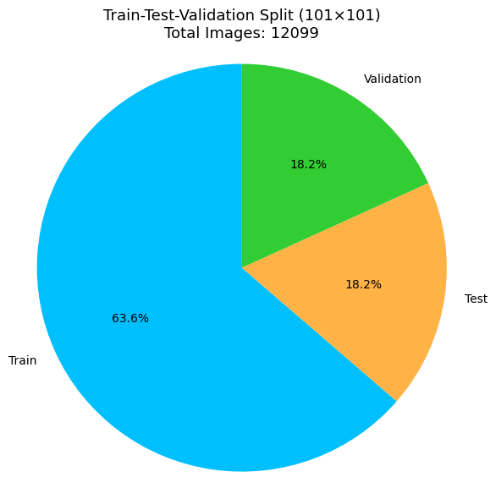
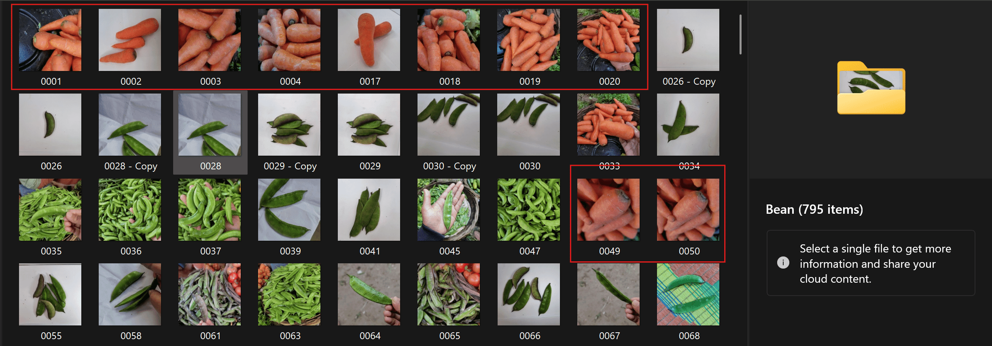
Dataset Overview
Dataset Split
Before diving into the vegetable classification task, I first took time to understand the dataset.
The dataset contains 12,099 grayscale vegetable images across 11 common classes, including:
Beans, Bitter Gourd, Bottle Gourd & Cucumber, Brinjal, Broccoli & Cauliflower, Cabbage, Capsicum, Carrot & Radish, Potato, Pumpkin, and Tomato.
All images were originally .jpg files sized at 224×224 pixels. As part of preprocessing, I converted them to grayscale and resized them to two working resolutions:
23×23
101×101
Set | Number of Images | Percentage
Training Set | 7,699 | ≈ 63.6%
Validation Set | 2,200 | ≈ 18.2%
Testing Set | 2,200 | ≈ 18.2%
Total | 12,099 | 100%
During early inspection, I found several Carrot images incorrectly placed in the Bean class folder. To prevent label noise:
I manually removed the incorrect images
Revalidated all class folders
Ensured only clean, trustworthy data was passed into the CNN.
This proactive quality check improves model training and supports fair evaluation later!

Slide 3
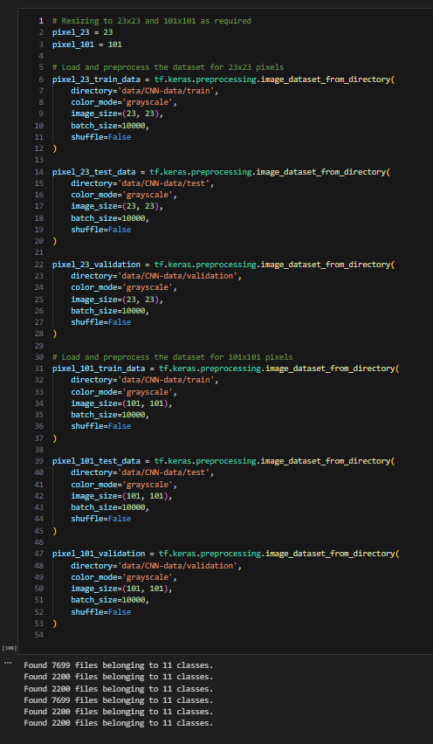
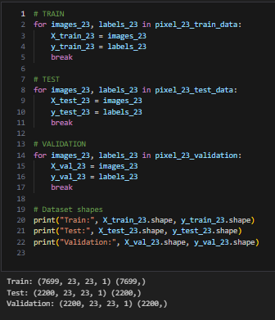
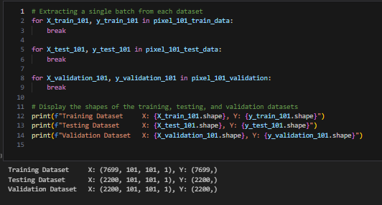
Loading & Preprocessing – Grayscale & Resizing
To kick off, I started by converting all original 224×224 RGB images into grayscale and resizing them to two resolutions:
23×23 – for faster, lightweight models.
101×101 – for richer feature extraction.
This step prepares two parallel input pipelines for fair comparison between low and high-resolution performance
Splitting 23x23 Data into X and y
After loading the full 101×101 datasets,
I extracted one batch from each set to split the data into:
X → the grayscale image tensors
y → the corresponding class labels
Splitting 101×101 Data into X and y
This confirms:
Grayscale format: 1 channel
Correct number of samples per split
Data is now cleanly separated into inputs (X) and targets (y)

Slide 4
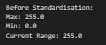
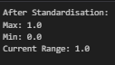
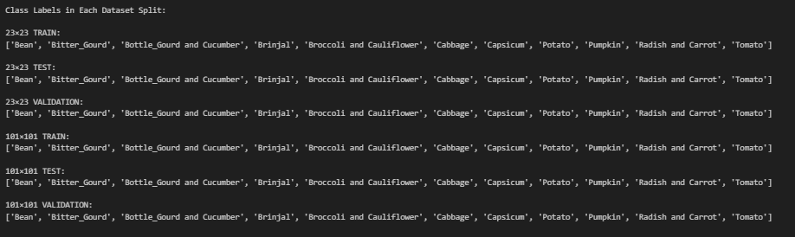
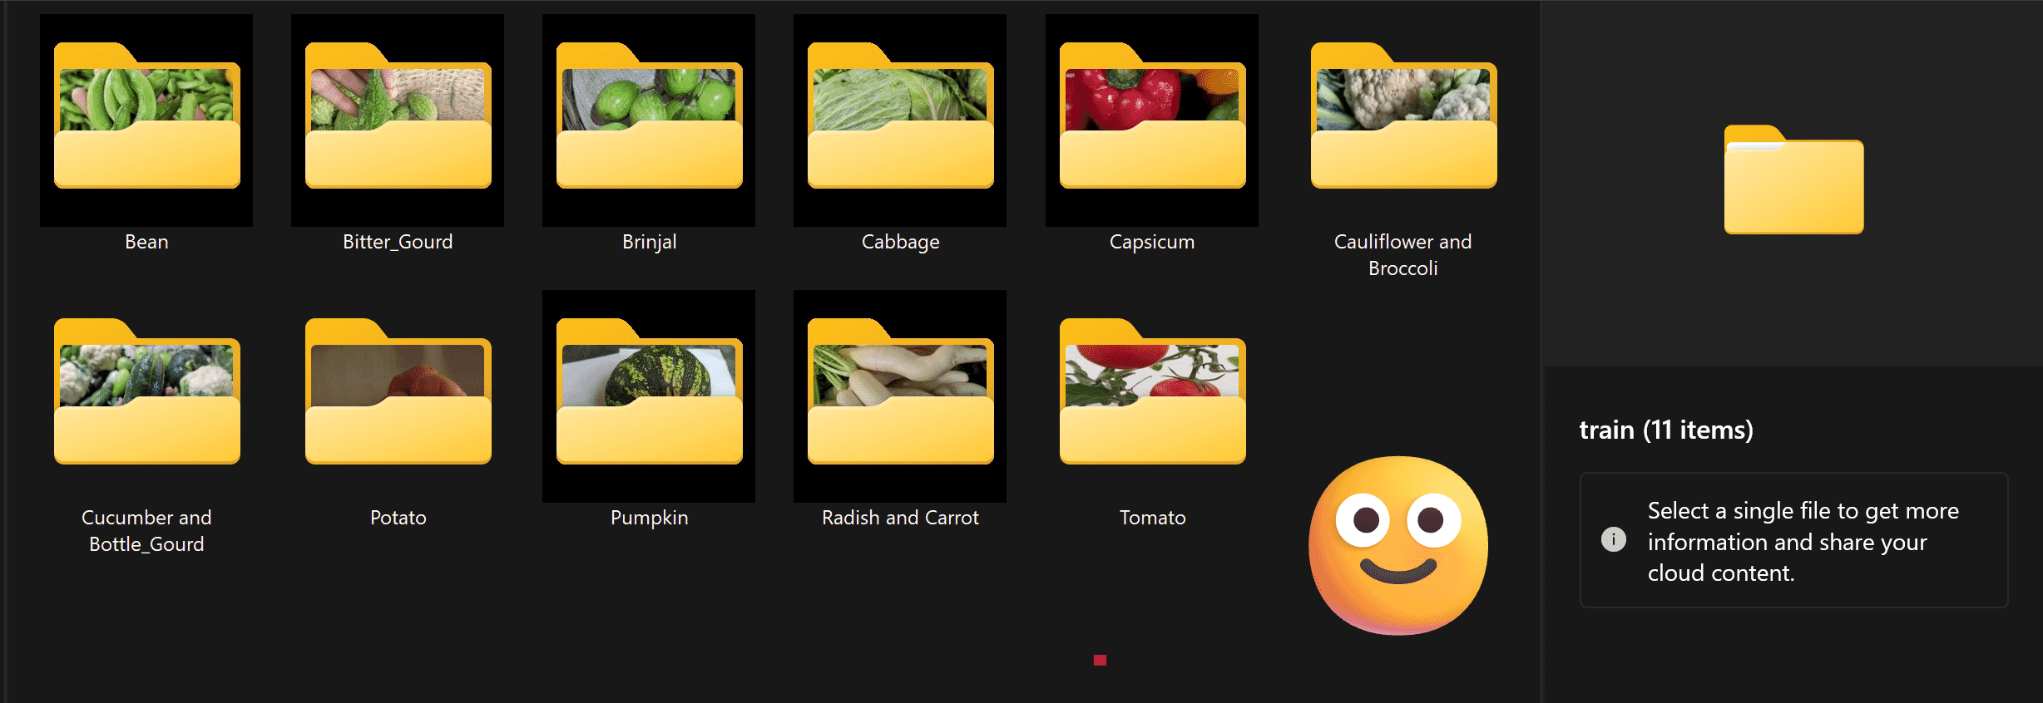
Preprocessing: Standardisation & Class Label Verification
I standardised the pixel values in the images.
Originally, each pixel had a value between 0 and 255. These values represent brightness in grayscale images.
To make the data easier for the model to learn from,
I divided all pixel values by 255, scaling them to a new range: [0.0, 1.0]
While browsing the dataset folders, I noticed more issues like:
Mismatched folder names e.g. Capsicum (apparently), Tomato (ostensibly)
Inconsistent phrasing e.g. Radish with Carrot, Carrot and Radish, etc.
Wrong images in wrong folders e.g. Tomato images inside Pumpkin folder ❌
To ensure reliable class separation and model training:
I renamed folders manually to match training set labels
Unified variant names under a single standard
Removed misplaced images across folders
Confirmed identical class names across train/test/val

Slide 5
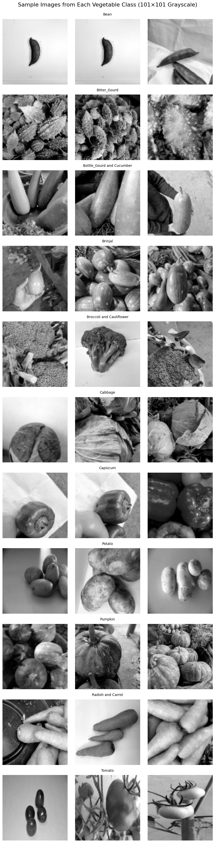
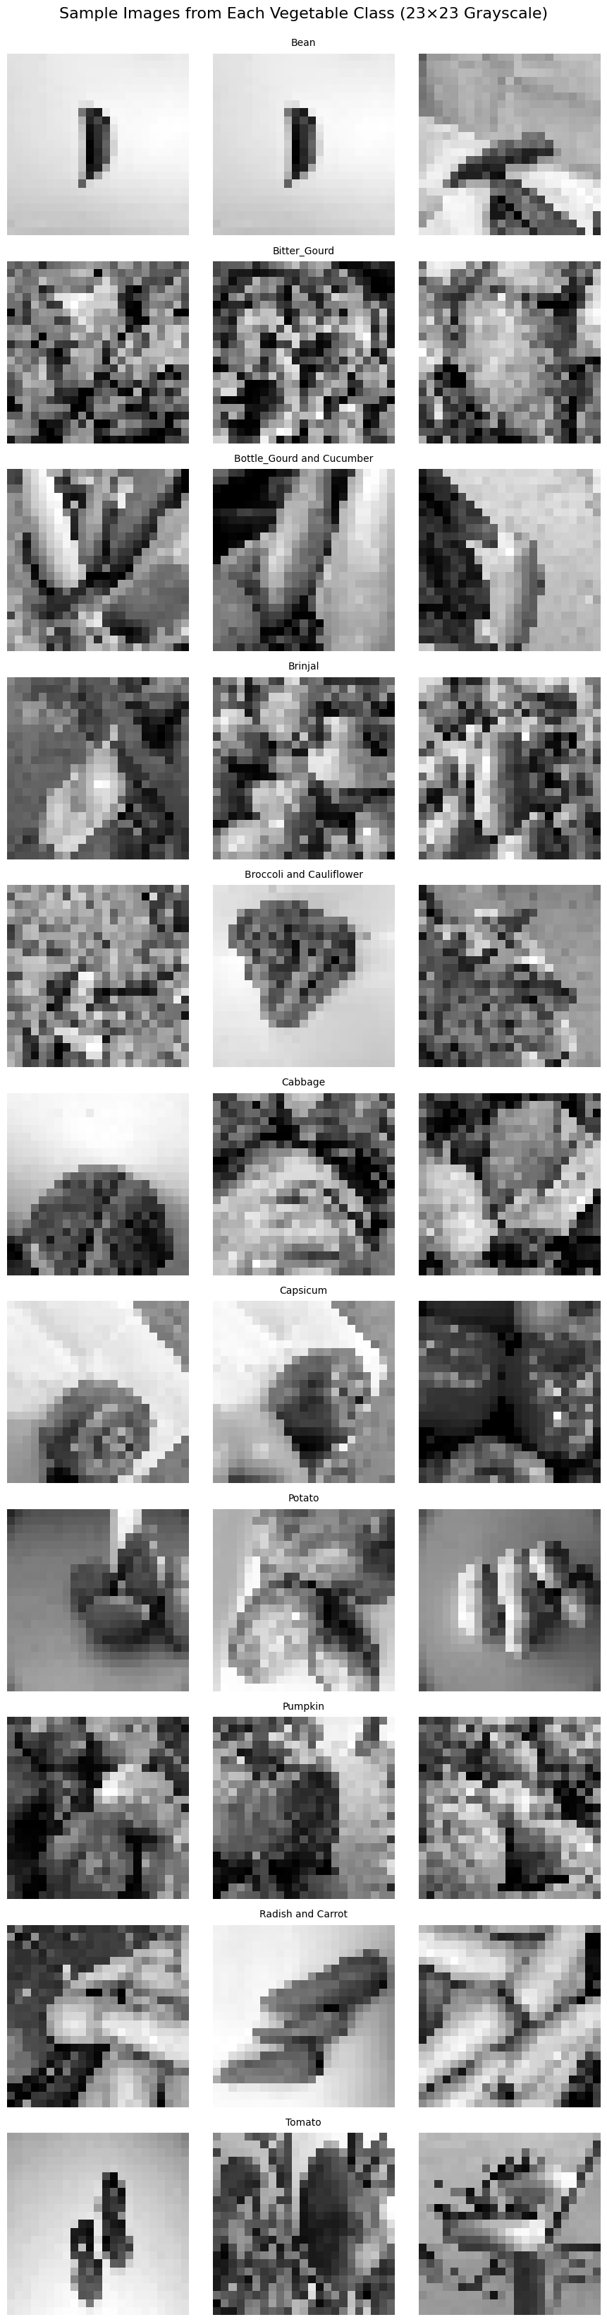
Exploratory Data Analysis: Visual Inspection of Classes
101x101 Images
23x23 Images
101×101 Grayscale – Visualising Class Samples
To evaluate the impact of resizing and grayscale conversion,
I visualised three sample images per vegetable class from the 101×101 training set!
I repeated the visualisation on the downscaled 23×23 training images
to understand how extreme compression affects image quality and class separability.
Observations (23×23)
Significant pixelation and loss of fine details
Classes like Potato, Pumpkin, Brinjal become hard to distinguish even for me!
Some edge patterns survive:
Carrot & Radish, Capsicum, and Broccoli & Cauliflower retain distinguishable shapes
Many images show overlapping tones and shapes, especially in grayscale
Observations (101×101)
Images retain high visual clarity and shape boundaries
Key textures and patterns are still recognizable
Each class is visually distinct, enabling the CNN to learn meaningful patterns
It’s clear that the 101×101 images preserve enough detail — making it much easier to see shape, texture, and edges clearly.
These results suggest that 23×23 models may need stronger feature extraction layers or additional preprocessing to succeed.

Slide 6
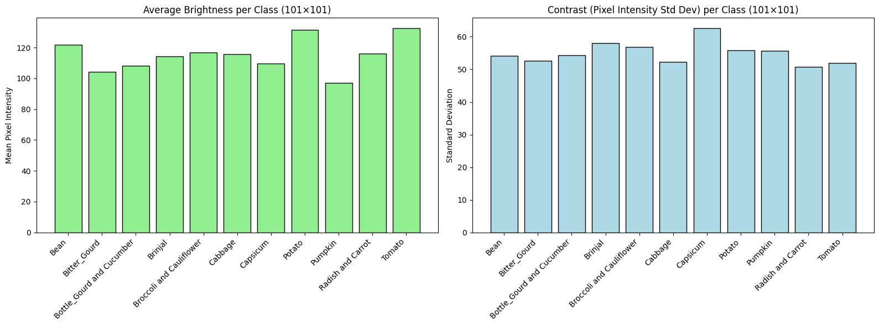
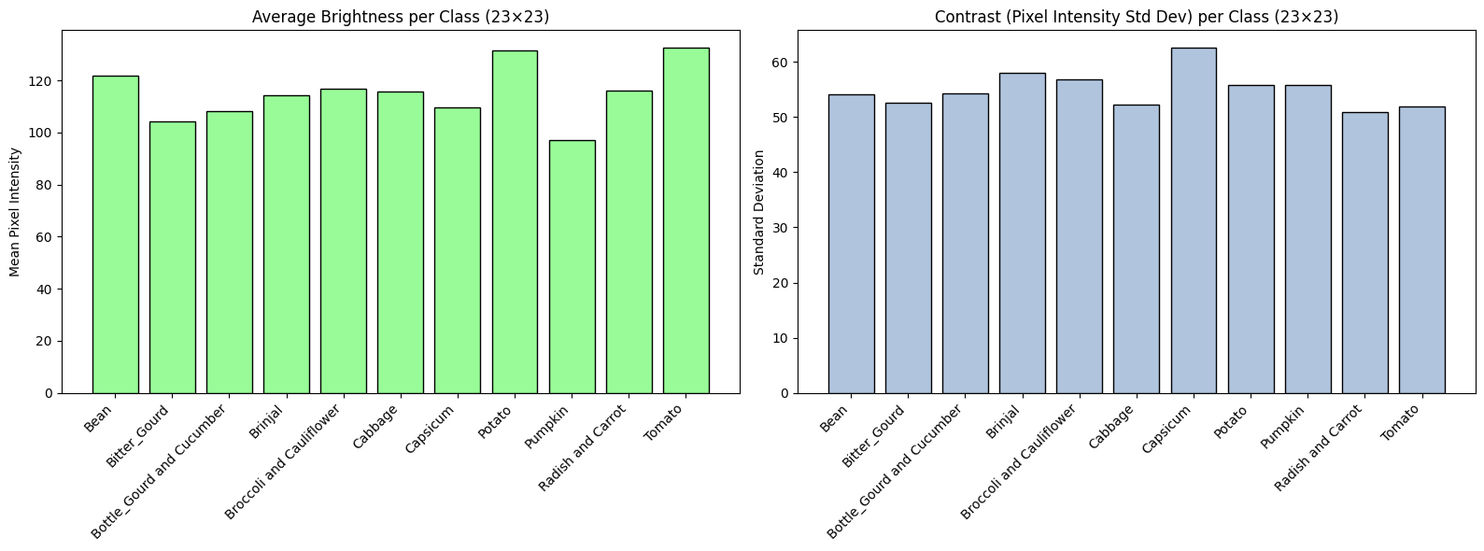
Exploratory Data Analysis: Brightness & Contrast by Class
I wanted to check if image resolution affects visual characteristics like brightness and contrast across classes. So I compared:
Average Brightness (mean pixel intensity)
Contrast (standard deviation of pixel intensity) for both 101×101 and 23×23 grayscale training images.
101×101 Analysis
Tomato and Potato had brighter images overall (higher mean values)
Pumpkin and Capsicum appeared darker (lower brightness)
Capsicum showed the highest contrast — meaning it has more texture and variation in its appearance → Likely due to mixed lighting or coloured edges even in grayscale
23×23 Analysis
Even after downscaling, the brightness and contrast trends were mostly preserved
However, finer differences becomes more compressed, especially in low-contrast classes like Tomato
This suggests that tiny visual cues may be harder to pick up in lower resolutions
Key Takeaways
✅ Brightness and contrast remained consistent across resolutions
✅ No major distortions were introduced by resizing
⚠️ But subtle edges and texture details (important for classification) may get lost at 23×23

Slide 7
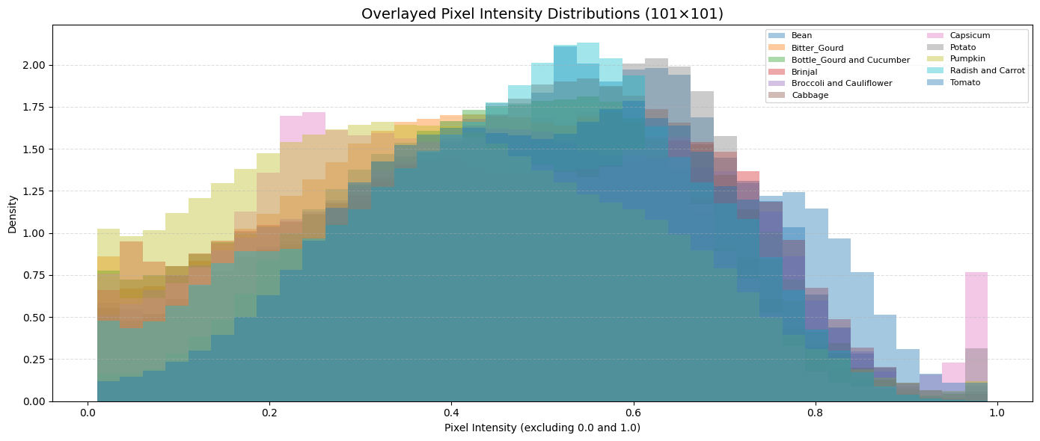

Exploratory Data Analysis: Pixel Intensity Distribution (Grayscale)
To check whether different vegetable classes have distinct brightness profiles, I plotted the pixel intensity histograms (0–1 range) for each class — using:
101×101 grayscale images
23×23 grayscale images
101×101 Observations
Most classes heavily overlap in brightness range
Dense clustering around the 0.4–0.7 midtones
Classes like Pumpkin, Cauliflower, and Cabbage share very similar tonal profiles
⚠️ Brightness alone isn’t enough to separate classes
So, just by looking at how bright or dark an image is, the CNN can’t tell the vegetables apart.
23×23 Observations
Even more compression in pixel intensity patterns
Many classes bunch together in the 0.5–0.7 range
Subtle tonal differences (between Pumpkin & Bitter Gourd) are lost
Overlap is more severe, increasing risk of misclassification
So for smaller images, the model may need:
More convolution layers to learn better features
Techniques to prevent overfitting
Augmentations that help the model handle low contrast

Slide 8
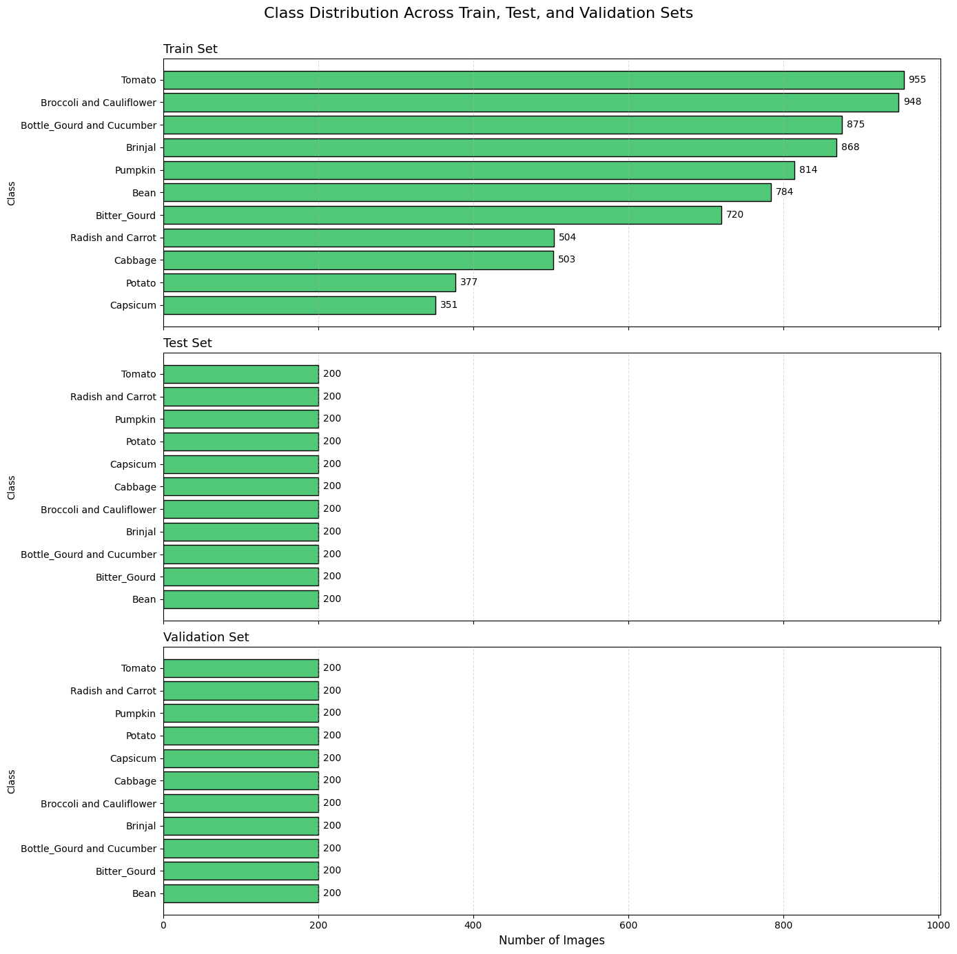
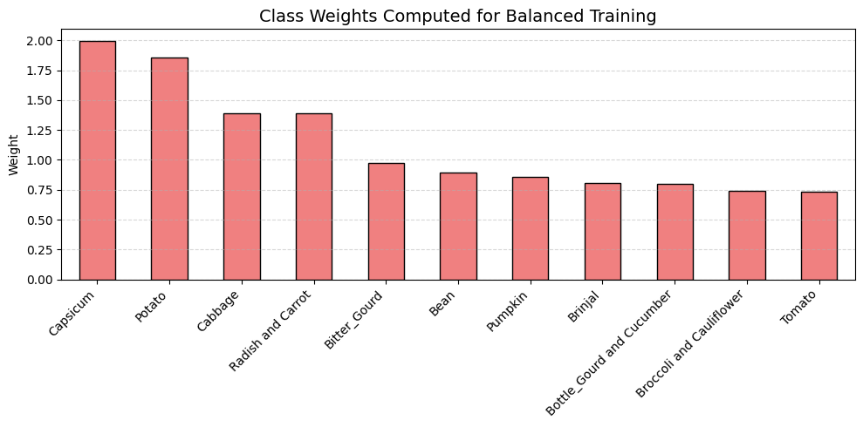
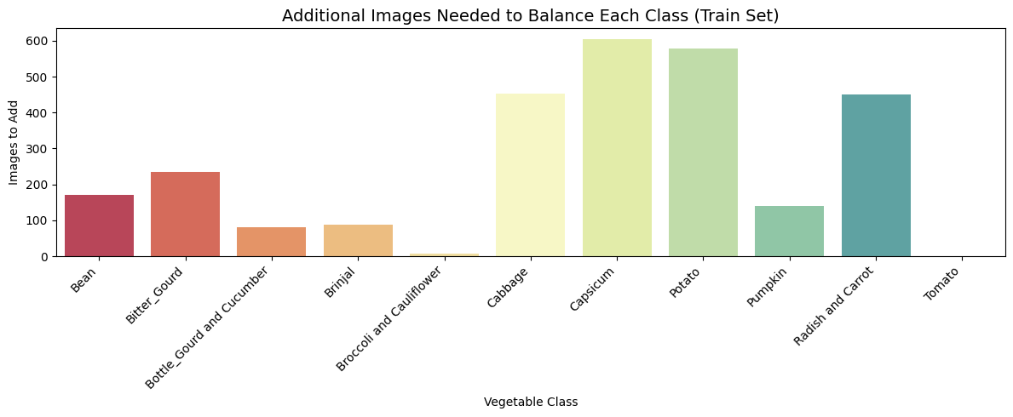
Exploratory Data Analysis: Class Distribution & Balancing Strategy
To check for data imbalance, I plotted the number of samples per class in the Training, Testing, and Validation sets using bar charts.
Key Findings
The training set is imbalanced
Classes like Tomato and Cauliflower & Broccoli have 850+ images
Others like Capsicum and Potato have fewer than 400
This can cause the model to focus more on majority classes,leading to biased learning and poor generalization!
To address the imbalance, I applied two complementary methods:
1) Oversampling Minority Classes (I’ll show later!)
I duplicated training samples from underrepresented classes
This ensured that each class had an equal number of images
Result: A fully balanced training dataset
2) Applying Class Weights During Training
I used class weights to make the model focus more on rare classes
Misclassifying minority classes results in a higher loss penalty
This ensures that the CNN treats all classes fairly during learning
Together, these two strategies improve model fairness, reduce bias,
and help the CNN learn from all 11 classes equally!

Slide 9
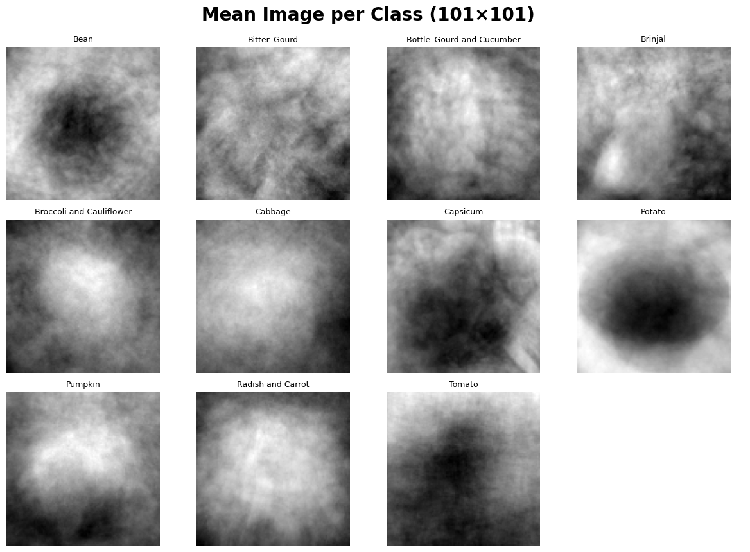
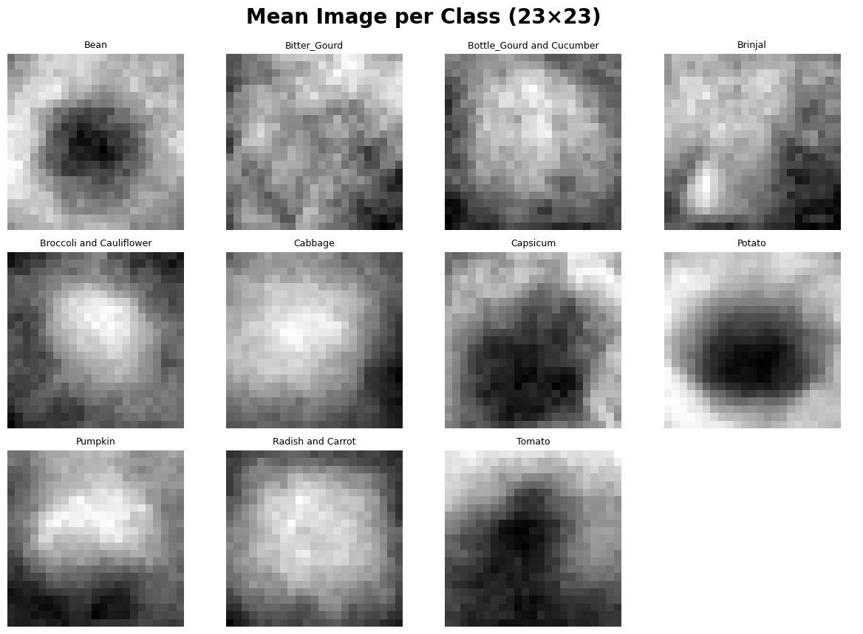
Exploratory Data Analysis: Mean Image Averaging & Class Consistency
Why I did this?
✅ I stacked and averaged all images from each class ✅ This gave me one “mean image” per class ✅ It helps reveal:
The common structure in that class
Whether the class has clear shapes or random noise
What This Tells Me
Why This Matters
✅ This tells me which classes are well-aligned and consistent ✅ And which ones need help via augmentation or model depth ✅ Instead of blindly training a CNN, I now know where it may struggle — and I can plan for that!
Observation | Explanation
Sharper shapes at 101×101 | More detail is preserved — clearer blobs for Tomato, Potato, Bean
Blurry patterns at 23×23 | Lower resolution loses fine edges — especially in Capsicum & Broccoli
Not all classes are consistent | Some like Cabbage and Capsicum vary a lot in shape and alignment!
CNN Impact | Classes with clearer averages are easier for CNNs to learn. Others may need stronger models or augmentation!

Slide 10
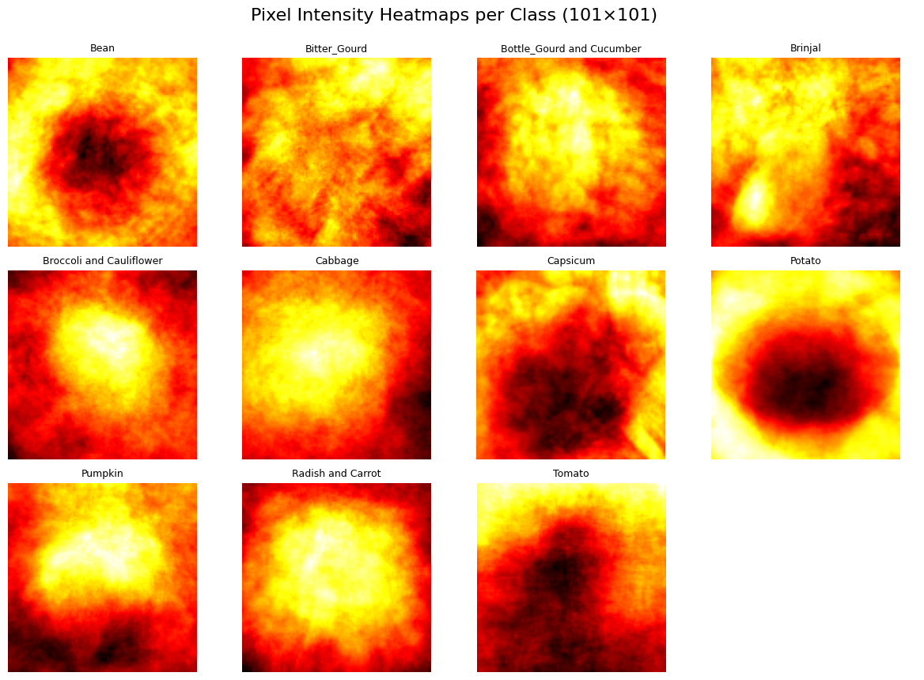
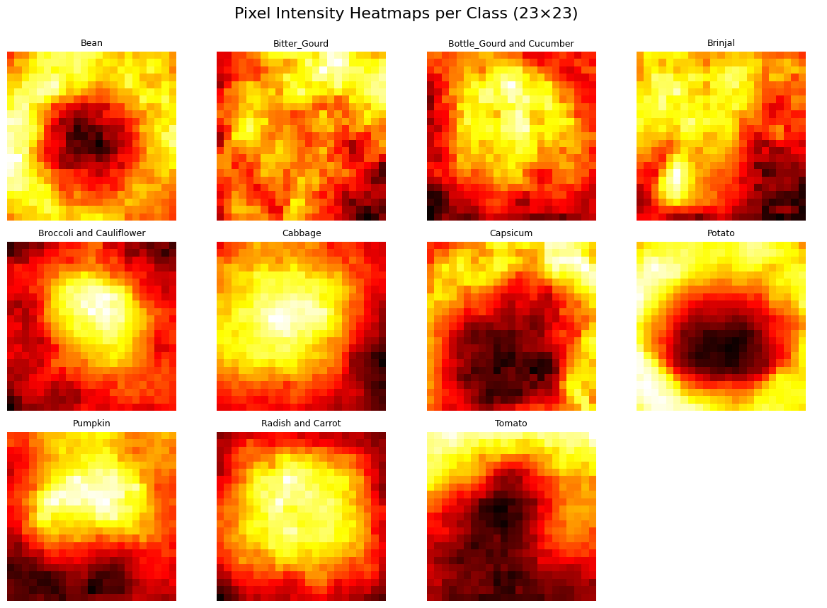
Exploratory Data Analysis: Pixel Intensity Heatmaps
What Are These Heatmaps?
✅ I averaged all training images in each class ✅ Then plotted the pixel intensity using a “hot” colour map ✅ Brighter = higher intensity (more activation), Darker = low intensity
Takeaways
Heatmaps show where each class is visually “active”.
Classes with more consistent activation zones (like Potato) are easier for CNNs to learn.
Lower resolution = weaker spatial clarity → CNN needs more layers, better augmentation, or both.
Resolution | Observations
101×101 | - Classes like Tomato and Potato have strong central hotspots 🔴- Shapes and structure are clearly visible- CNN can easily learn location-based patterns
23×23 | - Patterns get blurry and blocky- High-frequency texture is lost- Harder for CNN to extract good spatial features ☹

Slide 11
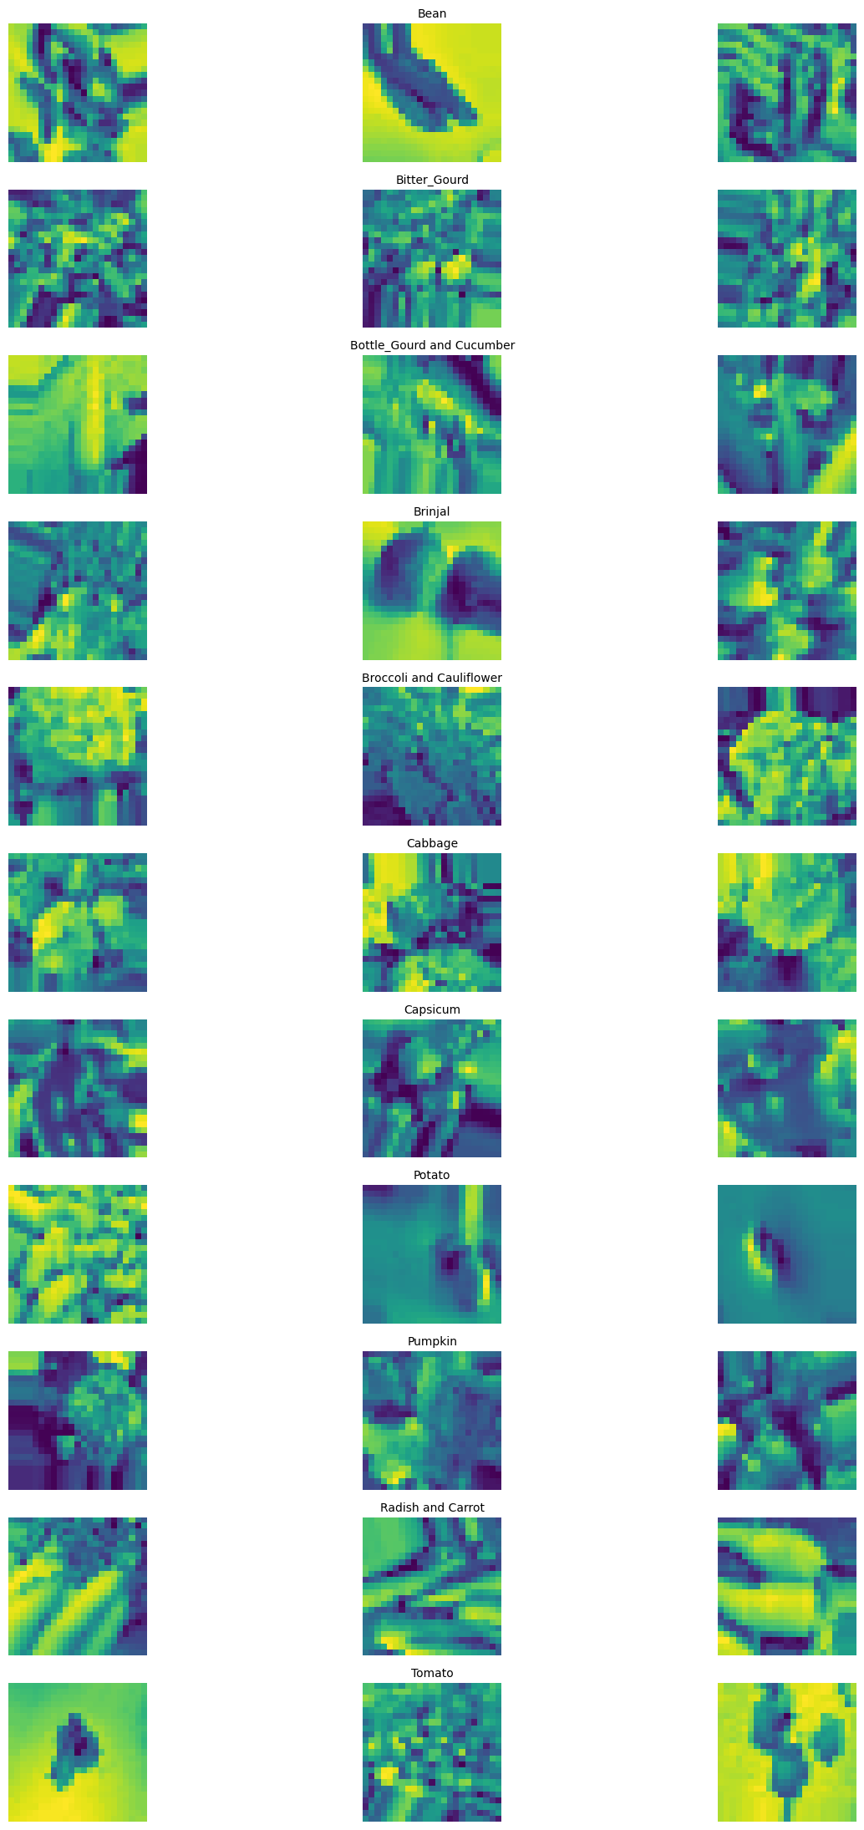
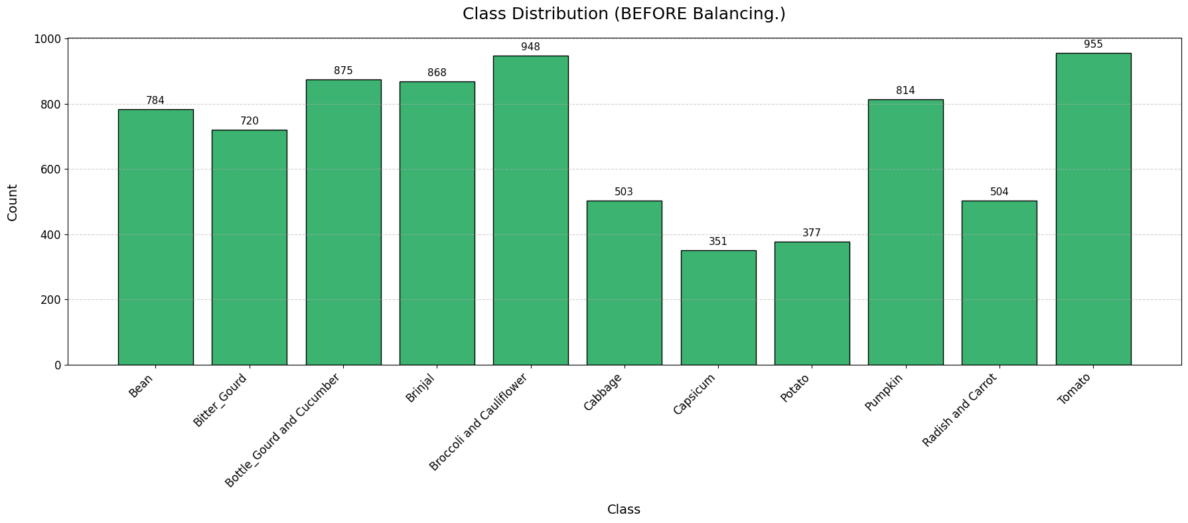
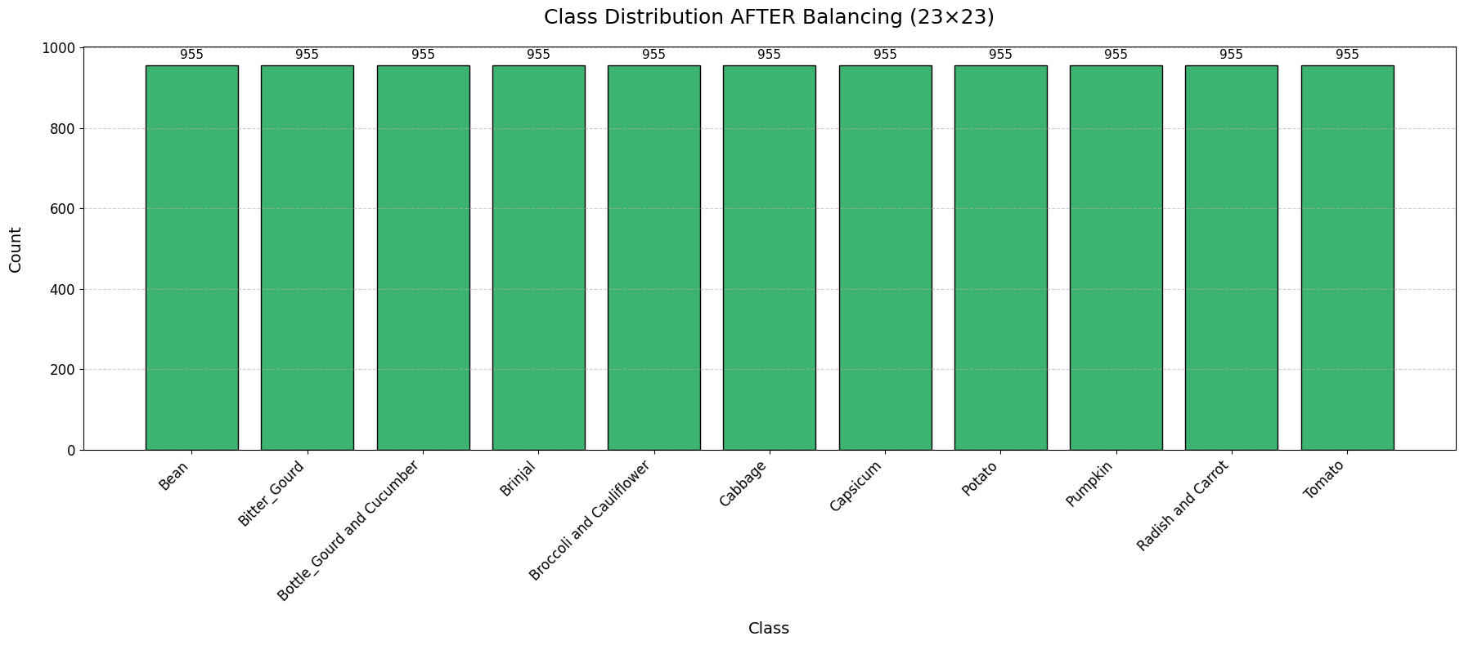
Data Augmentation & Preprocessing (23×23): Balancing with Oversampling & Visual Verification
✅ Problem Identified
Several classes like Capsicum, Potato, and Cabbage were severely underrepresented.
This could lead the model to bias toward dominant classes like Tomato during training.
Imbalanced datasets = unfair learning.
My 3-Step Solution Strategy
1. Convert to NumPy
Extracted all images and labels from the tf.data.Dataset.
This made it easier to perform balancing and augmentation directly.
2. Balance with Oversampling
Used sklearn.utils.resample to duplicate samples from minority classes.
All classes were matched to 955 images — the size of the largest class (Tomato)!
Achieved perfect class balance across all 11 vegetable categories.
3. Apply Image Augmentation
Transformations designed:
Rotation (±25°), shifting, zoom, brightness adjustment
Horizontal flips only (to preserve vegetable realism)
Although I configured an ImageDataGenerator (train_gen_23) with these augmentations,
I ultimately opted to use MixUp augmentation for training, which I’ll explain in later slides.
This strategic choice supports better regularisation and aligns with the final augmentation workflow used in my model.

Slide 12
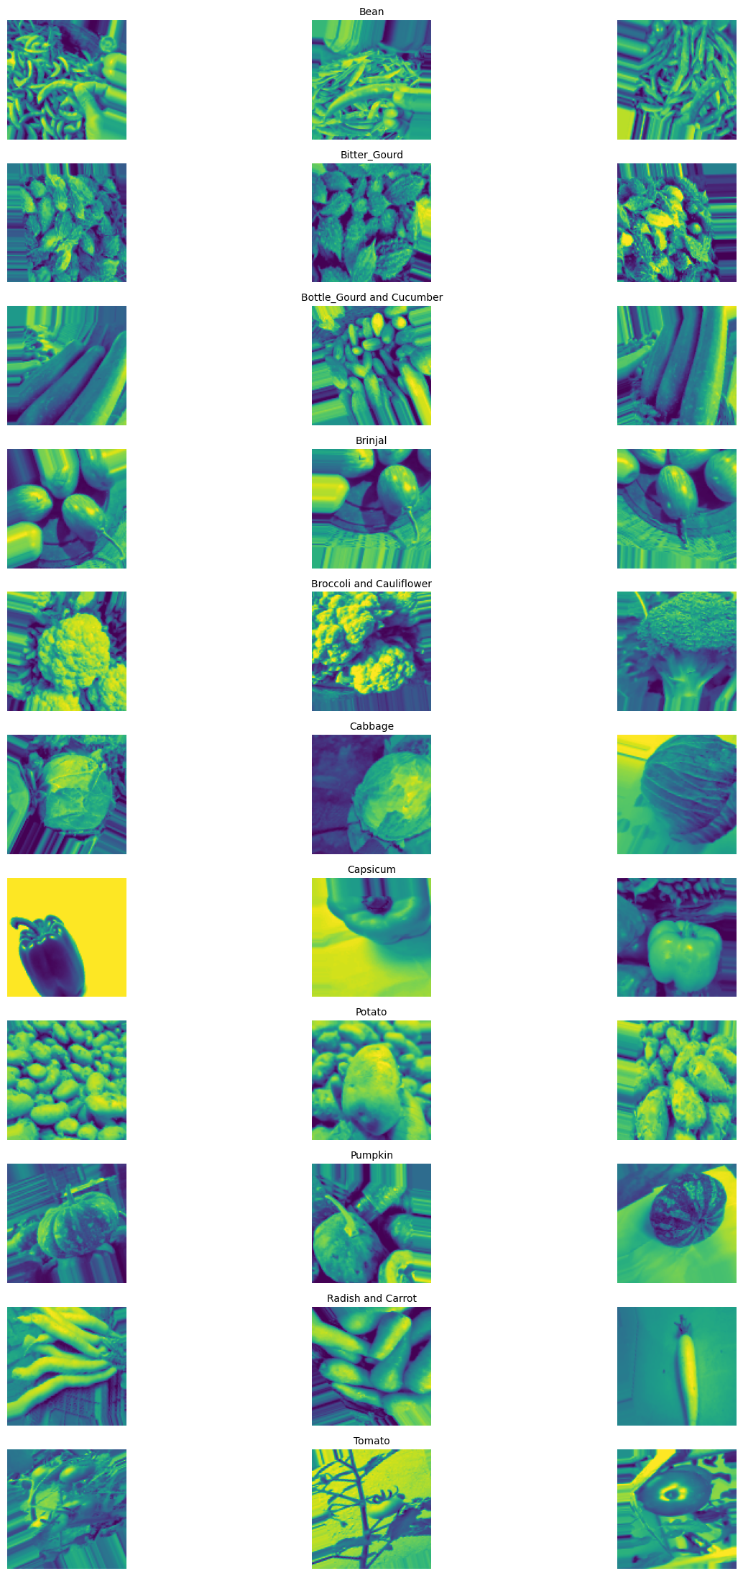

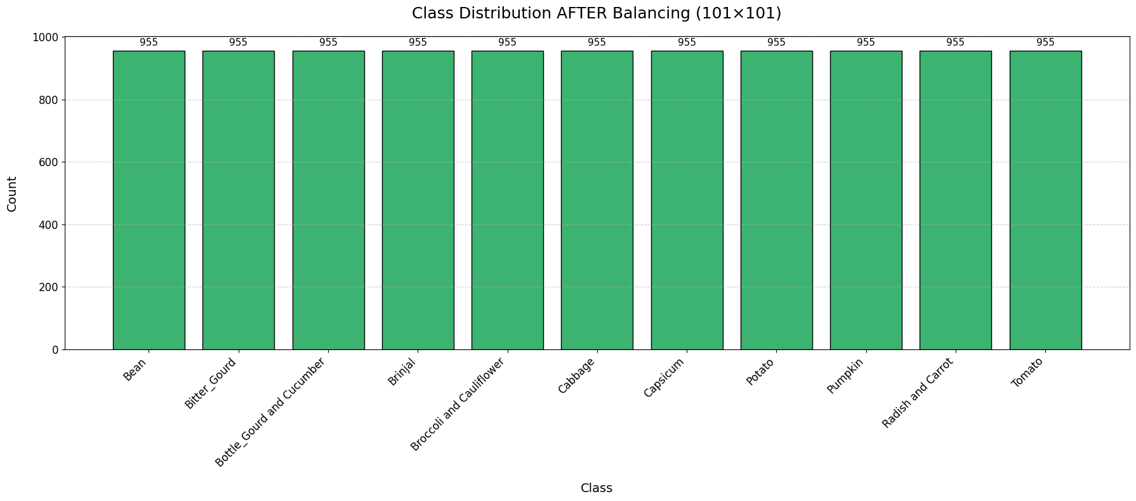
Data Augmentation & Preprocessing (101×101): Final Balancing & Visual Verification
Problem Identified
Classes like Capsicum, Potato, and Cabbage were underrepresented
Risk of bias toward dominant classes like Tomato
→ Imbalanced dataset = unfair training
My 3-Step Solution Strategy
1. Convert to NumPy
Extracted image-label pairs from tf.data.Dataset
Enables direct manipulation for balancing & augmentation
2. Balance with Oversampling
Used sklearn.utils.resample to duplicate minority class samples
Every class matched to 955 images (equal to Tomato)
➤ Achieved perfect balance across all 11 classes
3. Apply Image Augmentation
Applied via ImageDataGenerator (train_gen_23) with:
Rotation ±25°, shifting, zoom, brightness
Horizontal flip only to maintain vegetable realism
✅ However, I later switched to MixUp augmentation for training
→ More effective regularisation (explained in later slides)

Slide 13
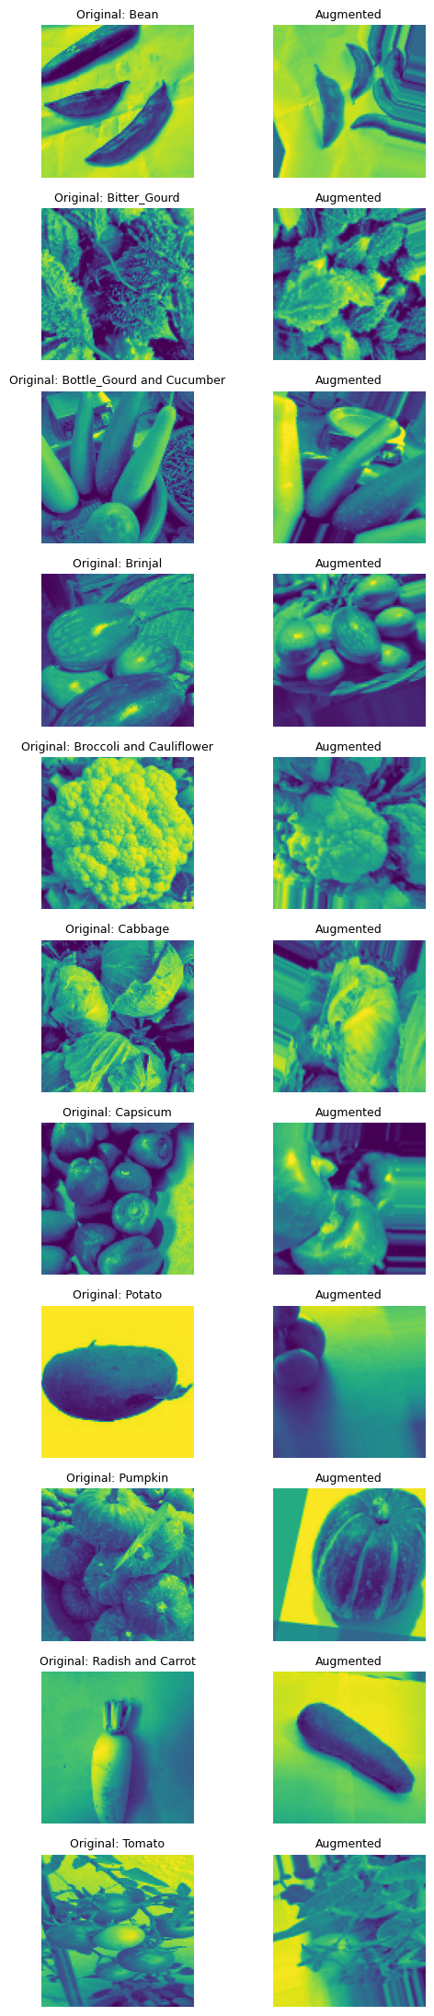
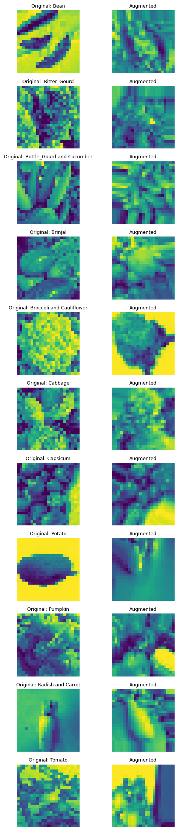
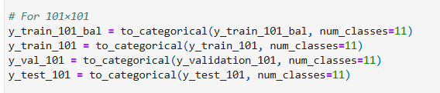
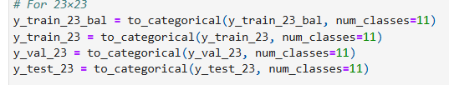
Exploratory Data Analysis: Original vs Augmented Image Comparison (23×23 & 101×101)
To visually confirm that augmentations applied during preprocessing were:
Class-preserving (vegetable identity is clear)
Visually diverse (introduces useful variation)
Training-suitable (realistic and not distorted)
At low resolution (23×23), preserving structure is critical as every pixel counts
At high resolution (101×101), augmentation must retain texture and form
This visual check gives me confidence that my augmentation pipeline is working as intended across scales
Final Validation
Both resolutions show class-consistent, visually distinct, and high-quality transformations
CNNs trained on this data will benefit from strong regularisation and generalisation capacity
For each of the 11 vegetable classes, I displayed:
Left: A randomly selected original image
Right: The augmented version using my pipeline
This was done for both 101×101 and 23×23 datasets.
One-Hot Encoding
101×101 Resolution
Preserved fine details and edges
Strong augmentation (rotation, zoom, flip, brightness) helped simulate real-world variance
All 11 classes augmented fairly
23×23 Resolution
Despite low resolution, shapes stayed clear
Augmentation introduced useful changes in angle, position, and contrast
No major distortion or mislabelling observed
Dataset | Before | After
Train | (10505,) | (10505, 11)
Validation | (2200,) | (2200, 11)
Test | (2200,) | (2200, 11)
All labels now match the model’s output layer format — ensuring compatibility and correct loss computation during CNN training.

Slide 14
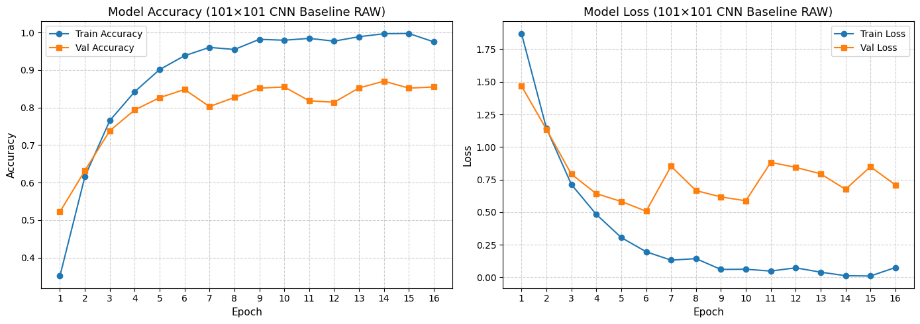
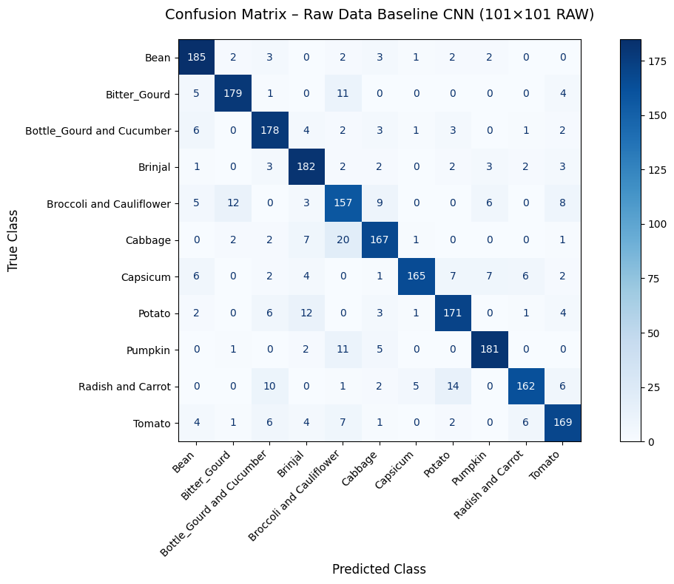
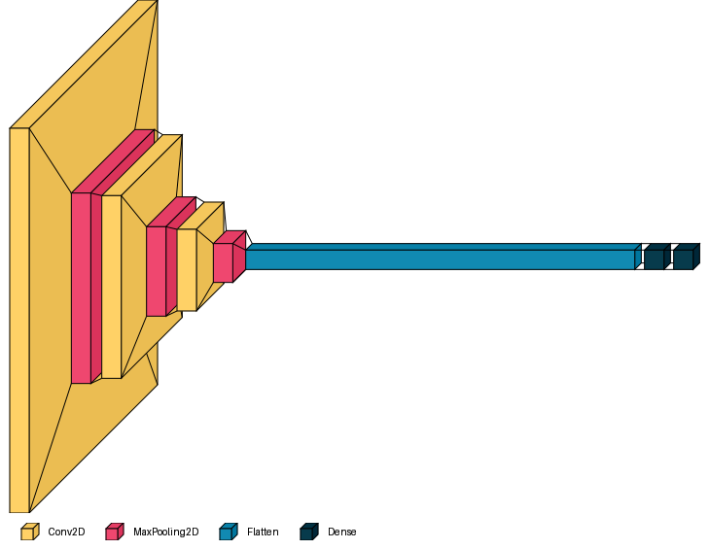
Modelling & Evaluation (101×101): CNN Baseline on Raw Imbalanced Data
Model Setup
A simple CNN with 3 Conv blocks → Flatten → Dense(128) → Softmax
Input: 101×101 grayscale vegetable images
Trained without balancing, augmentation, or extra regularisation
Purpose: To act as a clean benchmark
Early Stopping
Watched validation loss
Stopped if no improvement for 10 epochs
Restored the best weights for final model ✅
Model Structure (Visualkeras)
3× Conv2D → MaxPooling → Flatten → Dense layers
Nothing fancy — just a solid baseline
Key Points
Strong test accuracy (86.18%)without any augmentation
Great starting point to compare future models
Proves the power of clear architecture and good training flow
But This Made Me Wonder... 🤔
“Where exactly is the CNN focusing when it makes a prediction?”
This led me to explore Grad-CAM, a technique that shows what parts of the image the model looks at — coming up next! ☺

Slide 15
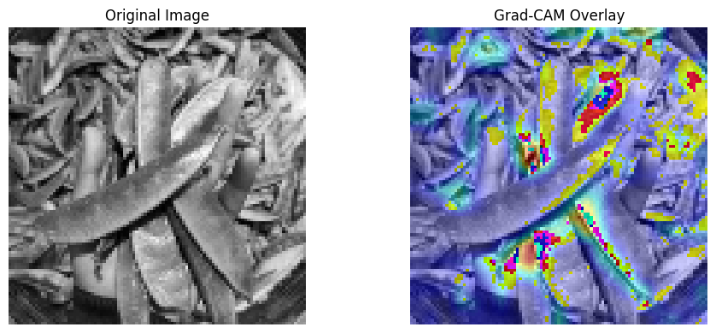
Grad-CAM Visualisation: Where Is My CNN Looking?
What Is Grad-CAM?
Gradient-weighted Class Activation Mapping (Grad-CAM) helps us see which parts of an image the CNN focused on during prediction.
It generates a heatmap that highlights the most influential regions used by the model.
Helps me move beyond just numbers — I can visually interpret why a prediction was made!
Why I Used It
I wanted to check if my baseline CNN (trained on raw, imbalanced 101x101 data) was really learning meaningful features, or just guessing based on dominant classes.
Inspired by Keras' official Grad-CAM tutorial.
What I Found
CNN attended to valid spatial features, like shape contours and texture areas.
Some heatmaps were broad and noisy, likely due to the lack of regularisation.
Yet, the model clearly learned where to look, even without data balancing or augmentation!
My Grad-CAM Setup
Picked last Conv layer: conv2d_5
Generated heatmap per prediction
Overlaid heatmap on original image
So, I can confirm that the CNN isn’t guessing — it's detecting real spatial patterns, This marks the first step towards explainable deep learning in my project!

Slide 16
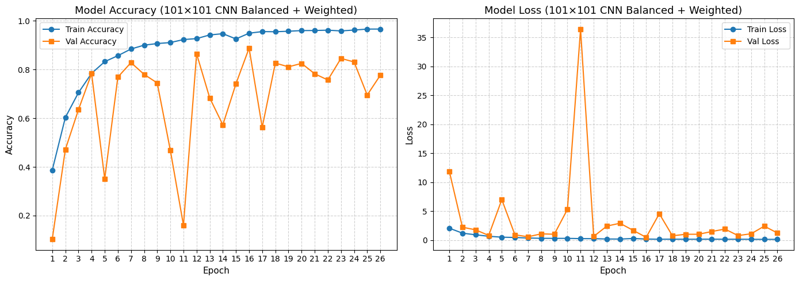
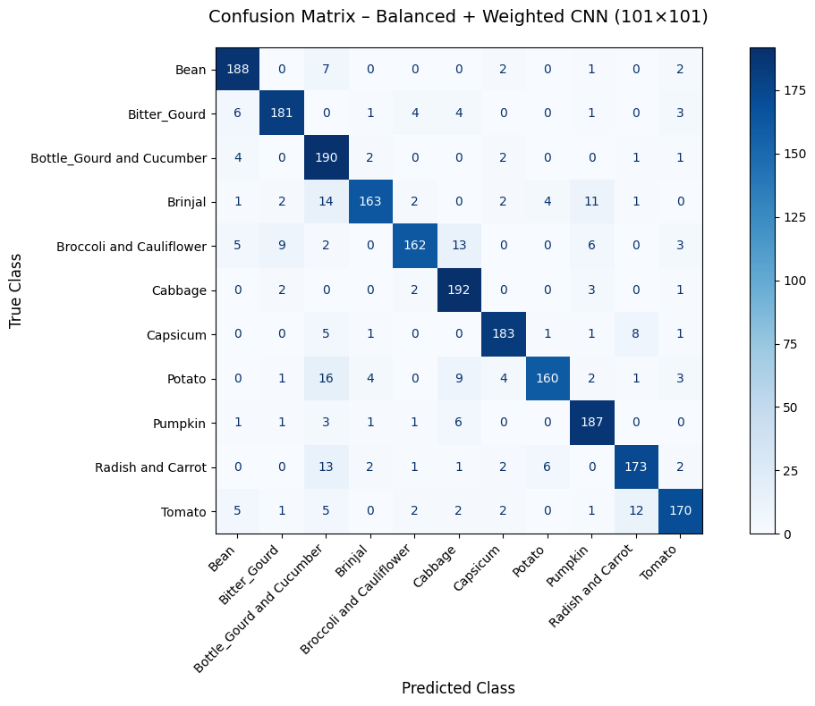
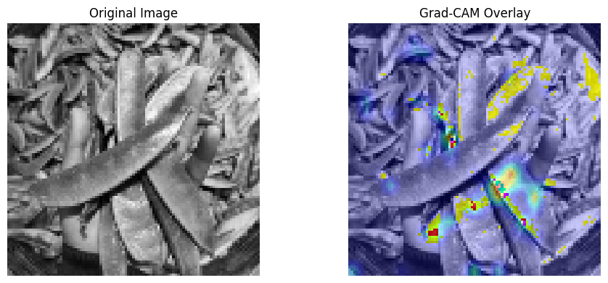
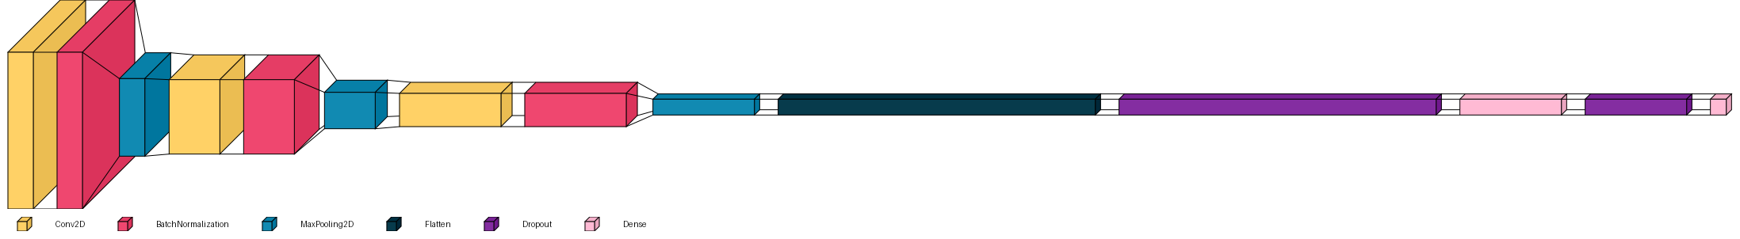
Modelling & Evaluation (101×101): Balanced + Weighted CNN Model
Why This Model Was Built
Raw baseline had high bias due to class imbalance.
I wanted a model that treats all vegetable classes fairly and accurately.
This version combines oversampling and class weighting to strengthen generalisation.
Why Use Both Balancing + Class Weights?
Technique | Purpose | Impact
✅ Balancing | Equal exposure to all classes | Prevents bias during sampling
✅ Class Weights | Focuses learning on rare classes | Makes misclassifying them more costly
Performance Summary
Test Accuracy: 88.59%
Test Loss: 0.461
Validation Accuracy Peak: 88.82% (Epoch 16)
Model Complexity: ~1.7M params
Outperformed baseline (86.18%) in all metrics ✅
Model focuses clearly on vegetable structure (edges, shapes)
Sharp heatmap on relevant regions
✅ Clear improvement over raw baseline Grad-CAM
What the Charts & Matrix Show
📈 Train Accuracy: Rose steadily to 97%
📉 Train Loss: Smooth convergence
⚠️ Val Loss: Fluctuates (common in class-weighted models)
✅ Confusion Matrix: Sharp diagonals, minority classes like Capsicum, Potato well classified
↔️ Minor confusion: Brinjal ↔ Bottle Gourd, Radish ↔ Tomato
Architecture at a Glance
3 × Conv2D → BatchNorm → MaxPooling
Total Params: 1.73M
Flatten → Dense(128) → Dropout → Output(11)
Visualised with visualkeras for interpretability
This model balances fairness, robustness, and accuracy ☺

Slide 17
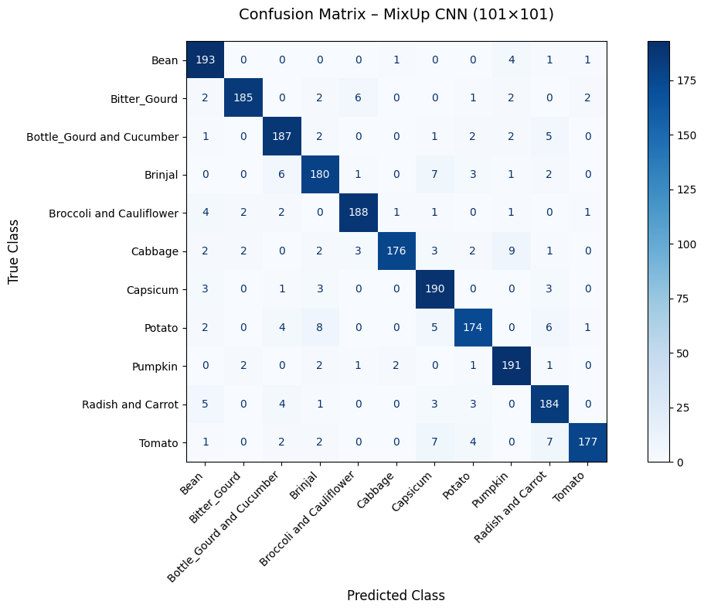
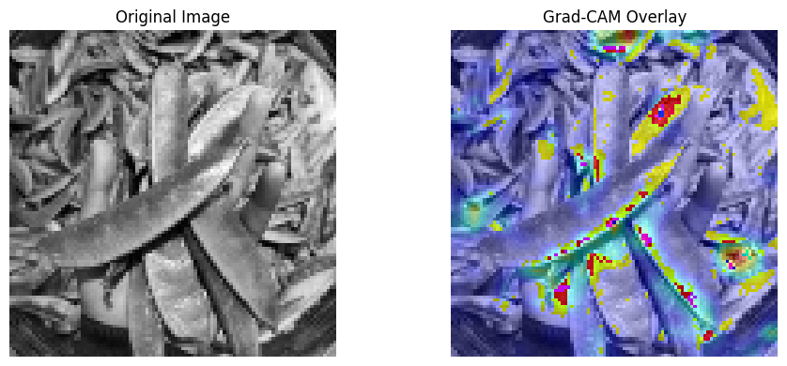
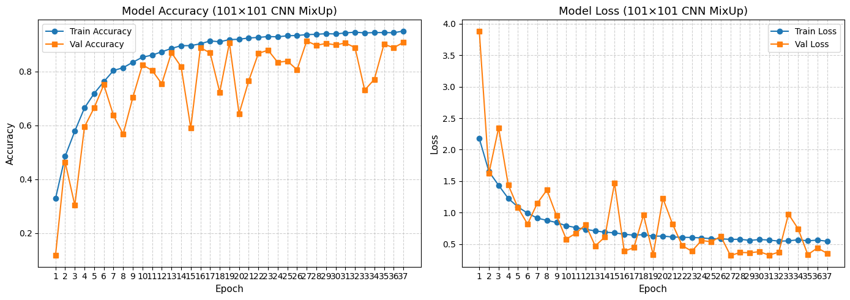
Modelling & Evaluation (101×101): MixUp-Augmented CNN Model
What is MixUp? MixUp blends two training images and their labels to create a synthetic example with a soft label. → Promotes smoother decision boundaries, reduces overfitting, and improves generalization!
Training Setup
CNN: 3 Conv Blocks + BatchNorm + MaxPool + Dense(128) + Dropout
Dataset: 101×101 grayscale, class-balanced
Augmentation: On-the-fly MixUp using custom generator
Optimised with Adam, EarlyStopping applied (best epoch: 27)
Key Strengths (based on Confusion Matrix & Grad-CAM):
Minority classes like Capsicum & Potato classified cleanly
CNN retained sharp attention on vegetable features despite MixUp
Heatmaps showed focused, noise-free attention on meaningful areas
Why I Used MixUp:
Balanced + Weighted CNN showed good accuracy but occasional val loss spikes!!
Some visually similar classes were still confused
MixUp helped the CNN learn from interpolated inputs → better robustness across all classes
Performance Summary
✅ Test Accuracy: 92.05%
✅ Test Loss: 0.3137
✅ Best Val Accuracy: 91.27%
✅ F1-Score (Macro): 92.05%
Outperformed all previous models in fairness, generalisation, and reliability!
✅ Conclusion: MixUp proved to be the most effective regularisation strategy, pushing model performance very well! It achieved top test accuracy while preserving interpretability and fairness across all vegetable classes.

Slide 18
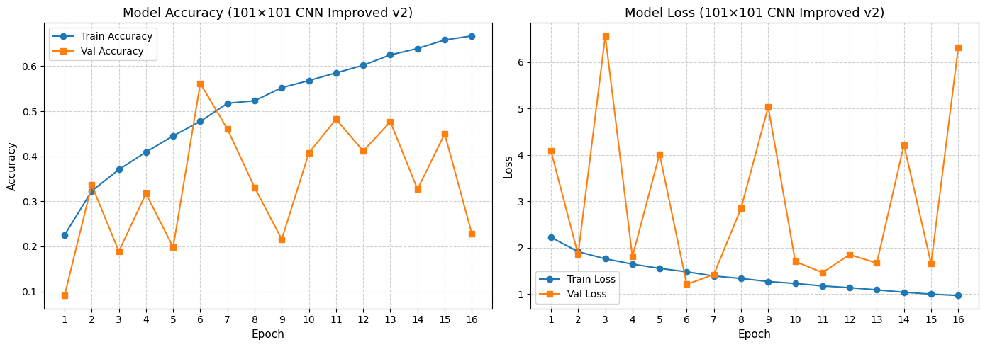
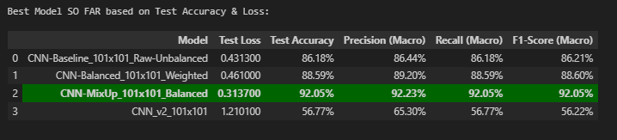
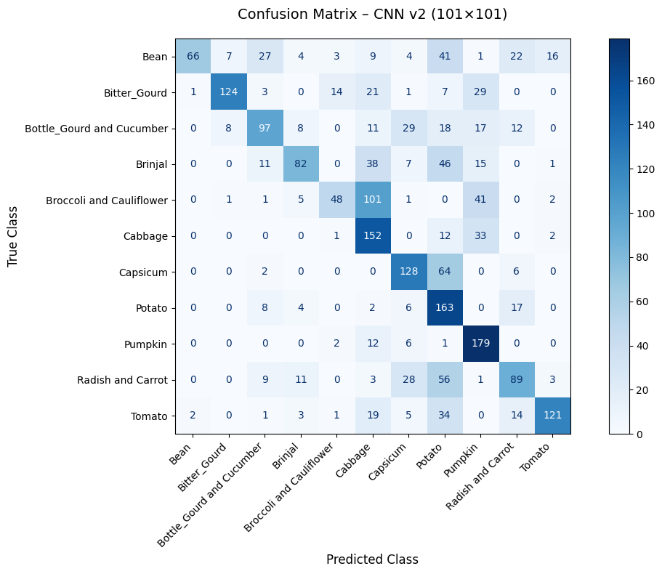
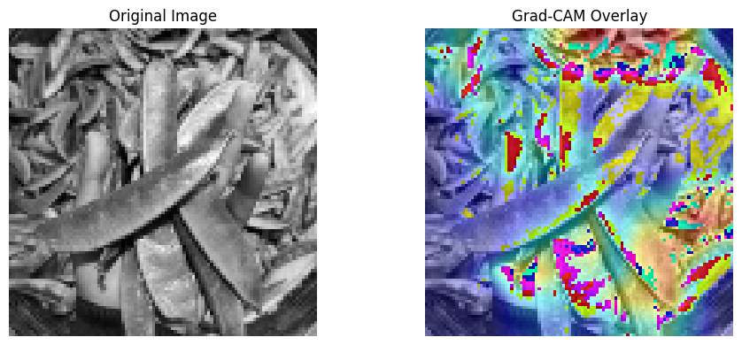
This made me ask myself: 👉 How can we fix these unstable validation losses and improve learning?
Modelling & Evaluation (101×101): CNN v2 (Deeper Architecture)
Experiment Objective
To explore whether a deeper CNN architecture with 4 convolutional blocks could extract more abstract features and improve performance on 101×101 grayscale vegetable images.
Architecture Design (What I Tried)
Tried 4× Conv2D blocks with LeakyReLU, Batch Normalisation, and increasing SpatialDropout2D (0.1 → 0.4)
Tried replacing Flatten with GlobalAveragePooling2D to lower overfitting
Tried stronger regularisation via Dropout and trained using Adam + EarlyStopping
Validation metrics were unstable and fluctuated, despite early stopping
Grad-CAM showed diffuse attention, lacking strong object focus
Observations & Takeaways
The model overfit ☹→ trained well but failed to generalise
Overfitting due to overparameterisation
Also known as high variance — too many parameters, too little data
Adding layers doesn’t always help. In fact, it made things worse here.
This highlights a key point as learnt in class!:
"More complexity ≠ Better results — the architecture must match data capacity and diversity."
Deeper models need MORE data and smarter augmentation. Without that, even the most sophisticated design can fail. This experiment taught me how to balance model architecture with data strategy! ✅

Slide 19
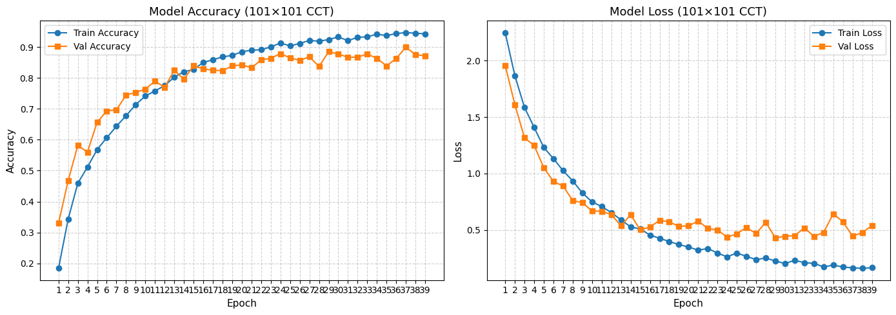
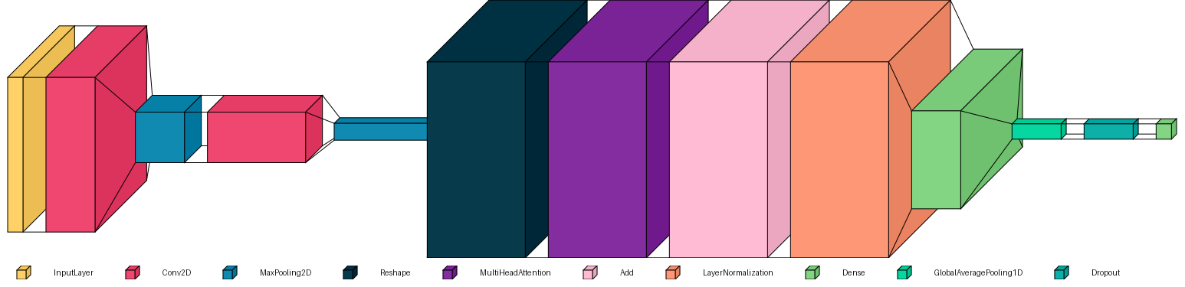
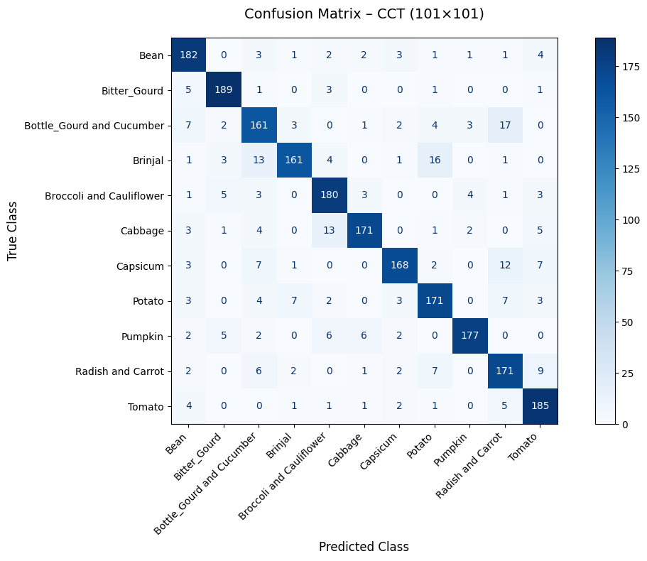
Modelling & Evaluation (101×101): Compact Convolutional Transformer (CCT)
Why I Tried This
Wanted to explore a hybrid model that blends CNN and Transformer strengths
Designed for small image datasets — perfect fit for this CA1 task
Learnt and adapted from Keras CCT example!
What I Learned
CCT handles both local patterns (via Conv) and global relations (via Attention)
First attempt at trying Transformers → and it worked!
How My CCT-CNN Model Works
CNN Tokeniser
I used 2 Conv2D + MaxPooling layers to extract important image features — like edges, shapes, and textures.
Image Kept Whole
The model processes the entire image as-is, without splitting it into pieces. This helps keep spatial patterns intact.
Transformer Encoder
MultiHeadAttention learns how different areas of the image relate to one another.
Add + LayerNorm keeps the learning stable and improves training flow.
Final Layers
After that, I added a Dense layer to learn deeper patterns, used GlobalAveragePooling1D to compress the output, applied Dropout to reduce overfitting, and finally used Softmax to classify the vegetable.
Performance Highlights
Test Accuracy: 87.09%
Strong class-wise balance (Confusion Matrix confirms)
Grad-CAM shows attention on relevant regions
Only 100K params — efficient yet powerful!

Slide 20
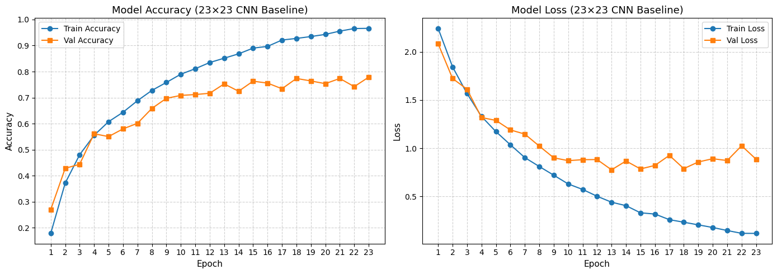
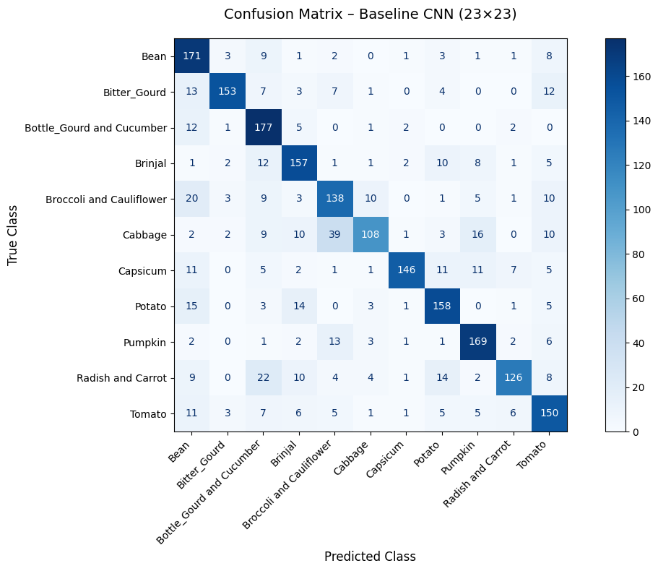

Modelling & Evaluation (23x23): Baseline CNN Model (Raw Unbalanced)
I started with a simple 3-layer CNN to set a clean benchmark using the raw 23×23 grayscale dataset — no balancing, no augmentation, just raw pixel patterns.
The model was trained using EarlyStopping to prevent overfitting and evaluated using test accuracy and macro scores.
Key Observations
Test Accuracy: 75.14%
Shows that even low-resolution grayscale images contain useful information for CNNs to learn from.
Minor class confusion due to overlapping textures (e.g. Brinjal, Cabbage, Cauliflower).
Classes like Pumpkin, Tomato, and Potato were classified well even without any enhancements.
I tried Grad-CAM, but the heatmaps looked too blurry at 23×23 — so I decided to try a better alternative: Occlusion Sensitivity 🤔✅

Slide 21

Interpreting Low-Res CNNs: Why Occlusion Sensitivity Works Better
What I Did
I switched from Grad-CAM to Occlusion Sensitivity to better explain my CNN’s decisions on 23×23 images.
Grad-CAM looked too blurry and unclear at this resolution — so I needed a method that gave sharper, pixel-level insights.
How I Did It
I created a custom function that hides small patches (3×3) of the input image one at a time.
After each patch is hidden, the model’s confidence is checked to see how much it drops for the correct class.
The result is a high-resolution heatmap showing exactly which parts of the image matter most to the model.
Why It Mattered
Clearly showed that the centre region holds the key visual cues.
Edges had little impact — proving the model looks at meaningful parts.
Delivered a reliable interpretation, even on tiny (23×23) images where Grad-CAM failed.

Slide 22






Modelling & Evaluation (23x23): Comparing Class Imbalance Strategies
What I Did
I trained three versions of my baseline CNN model on 23×23 grayscale inputs using different class imbalance strategies
Weighted-Only CNN: Trained on raw imbalanced data using class_weight during training.
Balanced-Only CNN: Oversampled training data so all classes had equal representation.
Balanced + Weighted CNN: Combined both techniques for maximum fairness and impact.
How I Did It
Applied class_weight (from EDA) to increase penalty for underrepresented classes.
Oversampled the dataset using stratified duplication to ensure equal class exposure.
Used consistent CNN architecture and training routines across all experiments to ensure fair comparisons.
Model Variant | Accuracy | F1 Score (Macro) | Key Insights
Baseline CNN | 75.14% | 75.09% | No imbalance handling
Weighted-Only | 77.68% | 77.61% | Best overall – fairness improved
Balanced-Only | 71.14% | 71.29% | Overfitted on repeated samples
Balanced + Weighted | 75.14% | 75.00% | More stable focus, fair predictions
Even with perfect class distribution, the model still needs guidance — that’s where class weights come in ☺

Slide 23







Modelling & Evaluation (23x23): MixUp-Augmented CNN Model
Key Observations – Accuracy & Loss
Training Accuracy steadily increased to ~94%, while Validation Accuracy stabilised around 78%, indicating strong generalisation.
Training Loss consistently decreased, showing effective learning,while Validation Loss plateaued early with minimal overfitting.
The gap between training and validation remains small → a clear sign that MixUp regularisation improved robustness.
Most predictions sharply aligned to diagonal → High confidence
Strong performance on:
Capsicum
Potato
Bean
Improved separation for Brinjal vs Tomato, and Radish vs Carrot
Minor residual overlap: Broccoli–Cauliflower still visually similar!
Why It Worked
Since MixUp trains on blended examples → Forces the model to generalise
Avoids overfitting to duplicated data from oversampling
Encourages focus on core object regions, not noise
MixUp + balanced data was my best CNN so far — beating all class-weighted models. It showed how smart augmentation improves generalization, though CCT ultimately performed even better.

Slide 24



Modelling & Evaluation (23x23): Compact Convolutional Transformer (CCT)
Why I Chose CCT
CNN + Transformer hybrid — gives both local and global feature learning
Performs well even on small 23×23 grayscale images
Inspired by my success with CCT on 101×101 — wanted to test on low-res too
Training Summary:
Smooth accuracy curve, no overfitting
Small train/val gap → strong generalisation
Beats all CNN-based models at 23×23
Results:
Test Accuracy: 82.14%
Test Loss: 0.6566
F1-Score (Macro): 82.18%
How I Adapted for 23×23:
Used smaller filters & pooling to avoid over-shrinking
Final CNN output = 11×11 tokens → passed into Transformer Encoder
Just 1 attention head to keep it lightweight
Ends with GlobalAveragePooling and Dropout to reduce overfitting
Occlusion Map
Attention is more spread out than CNNs
Learns to use context, even at low resolution
Even with small grayscale inputs, combining CNN tokenisation with transformer attention leads to better learning. This proves that CCT is a strong, lightweight option for low-res vision tasks! ✅

Slide 25



Pre-Tuning Performance Overview – Model Selection (23×23 vs 101×101)
✅ Top 2 Models (Selected for Tuning)
23×23 Resolution
CNN-CCT Hybrid – Best overall accuracy (82.14%) and F1-score (82.18%)
CNN-MixUp Balanced – Strong augmentation-based regularisation
101×101 Resolution
CNN-MixUp Balanced – Highest across all metrics (92.05%)
CNN-Balanced Weighted – Reliable baseline with class weights!
❌ Discarded Models:
Baseline CNNs (both resolutions)
Weighted/Unweighted 23×23 models (underperformed)
CNN_v2_101×101 (poor generalisation)
Why This Matters
By selecting only the top 2 models per resolution, I ensured that hyperparameter tuning is focused on the most promising candidates — improving efficiency and maximising gains!

Slide 26




Hyperparameter Tuning: CCT Hybrid (23×23) [RandomSearch]
Hyperparameter | Range Tested | Purpose
Conv1 Filters | 32, 64 | Sets number of filters in the 1st CNN layer → controls low-level feature extraction.
Conv2 Filters | 64, 128 | Sets filters in the 2nd CNN layer → captures more abstract spatial features.
Key Dimension | 32, 64 | Controls how much detail the Transformer looks at when focusing on different parts of the image.
Dense Units | 64, 128 | Number of neurons in classification head → affects decision complexity.
Dropout Rate | 0.2 to 0.4 (step=0.1) | Regularises the model → helps prevent overfitting by randomly disabling neurons.
Learning Rate | 0.001, 0.0001 | Controls learning speed → smaller values allow fine-tuning without overshooting.
+4.77% boost in test accuracy with tuning
Final model is more stable, accurate, and fair!
Key Takeaways from Tuning
Test accuracy improved from 82.14% → 86.91% after tuning (+4.77%).
Validation loss stayed stable, showing strong generalisation.
CNN layers captured local features; attention handled global context.
Tuning proved that CCT works well even on low-res grayscale data.
Best Hyperparameters
Conv1 Filters: 32
Conv2 Filters: 128
Key Dimension: 32
Dense Units: 128
Dropout: 0.2
Learning Rate: 0.001
✅ Best Model Configuration (Found by Tuner)
Search Time: ~3 hours on CPU
Validation Accuracy (Tuner): 83.36%
Final Test Accuracy: 86.91% ✅

Slide 27


Model Improvement: Manual CNN Architecture Grid Search (23x23)
Goal of the Grid Search
To discover the most effective CNN structure for classifying 23×23 grayscale vegetable images — by systematically testing different depths.
Performance Insights
Training stabilised around Epoch 31 where validation accuracy peaked at 83.73%
Learning rate reduced twice during training → boosted late-stage convergence
Architecture captured both shallow and mid-level spatial features effectively, without overfitting.
Key Takeaways
A moderately deep CNN (3 Conv, 2 Dense) was optimal for this small resolution.
Manual tuning of layers alone (no augmentation) delivered competitive results.
This grid search proved that architectural depth needs to match the dataset complexity — not too shallow, not too deep!
Search Configurations
Conv Layers Tested: 2, 3, 4
Dense Layers Tested: 1, 2, 3
Total Combinations: 9 model architectures
EarlyStopping + ReduceLROnPlateau were used to prevent overfitting and speed up convergence.
Best Architecture Identified
3 Convolutional Layers
2 Dense Layers
🟩 Final Test Accuracy: 82.82%
📉 Final Test Loss: 0.6461
This model generalised better than deeper or shallower configurations and achieved a high macro F1-score (82.74%) on unseen test data!

Slide 28



Hyperparameter Tuning: MixUp CNN (23×23)
Manual Grid Search (Architecture + Optimiser)
I manually defined a parameter grid to test different:
Activation functions: ReLU, LeakyReLU, ELU
Dense sizes: 64, 128, 256
Dropout rates: 0.3, 0.5, None
Conv blocks: 2 or 3
Optimisers: Adam and RMSprop
All models were trained on MixUp-augmented data using EarlyStopping and ReduceLROnPlateau.
Best Manual Result: Test Accuracy: 79.73% (Only +1.5% improvement over pre-tuned model)
To improve model performance, I explored two tuning approaches:
1.Manual Parameter Grid Search
Manually adjusted architecture components such as activation functions, dropout, dense units, third Conv layer, and optimisers.
Allowed for controlled experimentation across regularisation and model depth.
2.Automated Tuning via KerasTuner (RandomSearch)
Systematically searched over key hyperparameters like convolutional filters, dense layer size, dropout rate, and learning rate.
Achieved the best overall configuration with a +4.72% test accuracy improvement.
Automated Tuning – KerasTuner (RandomSearch)
I tuned 3-block CNNs using KerasTuner to explore key hyperparameters: Conv Filters, Dense Units (64–256), Dropout Rate (0.2–0.5), and Learning Rate (1e-2, 1e-3, 1e-4).
Final Test Accuracy: 82.95% Macro F1-Score: 82.92%

Slide 29




Hyperparameter Tuning: MixUp CNN (101x101)
After reviewing all baseline models, I selected CNN-MixUp_101x101_Balanced as the strongest candidate for hyperparameter tuning due to its excellent generalisation. My goal was to further push its performance beyond 92% accuracy while maintaining robustness.
Summary – Tuned MixUp CNN (101×101) The final tuned model achieved strong generalisation with a validation accuracy of ~98% and stable training behaviour, thanks to ReduceLROnPlateau and EarlyStopping.
Confusion matrix analysis showed >195 correct predictions for most classes, with minimal confusion between similar vegetables like Brinjal–Tomato and Radish–Carrot.
Grad-CAM visualisations confirmed that the model focused on key object features rather than background noise, proving that hyperparameter tuning, MixUp regularisation, and architectural enhancements led to a highly robust and interpretable classifier.
Tuning Strategy
I applied a blend of automated search (via KerasTuner) and manual refinements, exploring:
Model Architecture: Conv filter counts, 3rd ConvBlock inclusion, and GlobalAveragePooling2D vs Flatten
Activation Functions: ReLU vs LeakyReLU
Regularisation: Dropout rates (0.2–0.4),ReduceLROnPlateau
Optimiser Settings: Learning rates (1e-3, 5e-4, 7.89e-4)
Data Augmentation: MixUp α ∈ {0.2, 0.3}, Batch sizes ∈ {16, 32, 64}
Each trial used mixup_data_generator() and was evaluated via val_accuracy. Final metrics were recorded and compared across all settings.
📈 +5.5% Accuracy Gain after tuning.

Slide 30



Hyperparameter Tuning: Balanced + Weighted CNN (101×101)
Accuracy Improved: Test Accuracy increased from 88.59% → 91.95% (+3.36%)
Metric Gains: Macro Precision (+2.90%), Recall (+3.36%), F1-Score (+3.35%)
Effective Tuning: Filters = 32–64–192, Dense = 128, Dropout = 0.4 / 0.3, LR = 0.001
Validation Trends:
Accuracy stabilised ~92%, closely matched test accuracy
Validation loss fluctuated (due to class weights), but generalisation remained strong
Confusion Matrix: Robust per-class performance with minimal confusion
✅ Conclusion: Tuning significantly enhanced class balance, accuracy, and robustness!

Slide 31


Final Model Evaluation
23×23 Dataset
Top Model: Tuned CNN-CCT Hybrid Test Accuracy: 86.91% | F1-Score: 86.99%
Strong Contenders:
Tuned CNN-MixUp: 82.95%
CNN-Best Config (Grid Search): 82.82%
Insights:
CCT’s combination of CNN tokenisation + Transformer attention led to superior generalisation.
Confusion matrix showed balanced class-wise performance with minimal misclassifications.
Particularly strong on difficult classes like Capsicum, Pumpkin, and Radish & Carrot.
101×101 Dataset
Top Model: Tuned CNN-MixUp Test Accuracy: 97.55% | F1-Score: 97.55%
Next Best:
Tuned CNN-Balanced + Weighted: 91.95%
Insights:
MixUp regularisation + hyperparameter tuning produced outstanding generalisation.
Confusion matrix revealed near-perfect class predictions with minimal overlap.
Most classes achieved 195–198 correct predictions out of 200, with almost zero noise.
✅ Conclusion
Best Overall Model (23×23): Tuned CNN-CCT Hybrid
Best Overall Model (101×101): Tuned CNN-MixUp
Both models demonstrated strong generalisation, handled class imbalance effectively, and are ideal candidates for deployment.

Slide 32







Model Deployment (Real-World Testing)
23×23 – Tuned CCT Hybrid
Test Images: Same Google set, resized to 23×23
Model Performance
Strong predictions despite low resolution
Bean: 99.87%, Tomato: 99.94%, Cauliflower: 71.55%
A few misclassifications:
Carrot → Tomato
Cucumber → Capsicum
Insight
These errors likely arose due to limited visual cues in the 23×23 grayscale format.
Carrots were particularly affected — the absence of leafy tops in training images reduced visual distinctiveness, leading to confusion with similar root vegetables.
Verdict:
✅ Compact yet effective
✅ Transformer attention mitigated low-res limitations
⚠️ Minor class ambiguity under extreme resolution constraints
101×101 – Tuned MixUp CNN
Test Images: Google-sourced, real-world diversity
→ Grayscale converted and resized to 101×101
Model Performance:
Accurate, confident predictions across most classes
Bean: 100%, Cauliflower: 99.66%, Tomato:94.02%
Minor issue: Carrot misclassified as Tomato (91.54%)
Insight:
I realized that carrots in the training set lack leafy tops — causing the model to confuse root textures with tomato or radish!
Verdict
✅ Excellent generalisation
✅ Resilient to noise and variation
✅ Best candidate for deployment

Slide 33
Thank You ☺
DELE CA1 – Part A By Balamurugan Siddhartha

